Slide 1
INDOOR NAVIGATION SYSTEM

Slide 2
Mechanics of Magnetic Positioning
Magnetic positioning was inspired by animal wayfinding in nature (e.g., birds, bats, bees, salmon, foxes, etc.)
Smartphones are similarly able to detect and respond to magnetic field variations inside buildings.
Each building or structure has a unique magnetic “fingerprint,” based on the way building materials affect and “distort” the otherwise persistent magnetic field generated by the Earth
Those patterns can be precisely assigned to a building floor plan
Smartphone owners (iOS and Android) can then be accurately located inside retail stores, hospitals, malls, airports and other indoor spaces.

Slide 3
Why Magnetic Field?
Gps is inaccurate indoors.
No External Hardware required.
Minimum Cost
Accurate

Slide 4
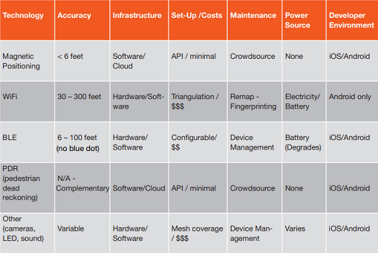
Comparing Technologies: WiFi, BLE and Magnetic

Slide 5
Magnetic Fields Inside Buildings
Earth’s magnetic field is present everywhere
Ambient magnetic fields indoors comprise of disturbances in the Earth’s magnetic caused by the ferromagnetic nature steel structure
This distortion of the magnetic field is precisely what enables it to locate people indoors.
Steel and concrete help create the unique magnetic fingerprints or signatures of buildings.

Slide 6
WORKING
The essence of indoor localization based on geomagnetic field is geomagnetic matching.
Geomagnetic Matching - Magnetic data collected by the user will be matched against the magnetic map of the building which is stored on a cloud, in order to accurately position the user.

Slide 7
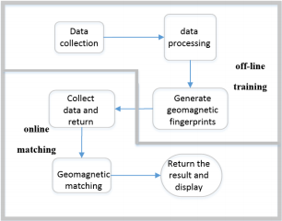
WORKING
GEOMAGNETIC POSITIONING
Geomagnetic positioning can be divided into two stages: offline training and online matching.
OFFLINE TRAINING
The main purpose of the offline training is to generate geomagnetic fingerprints.
ONLINE MATCHING
The main purpose of online matching is for real-time positioning.

Slide 8
WORKING
GEOMAGNETIC FINGERPRINTS - anomalies caused by magnetic disturbances of the Earth’s geomagnetic field can be used as a “fingerprint” to describe the environment - the more variable the local anomalies, the more unique is the fingerprint.
MODULES
DATA COLLECTION
This module collects the geomagnetic signals of the current location through the mobile device at the time of data pre-acquisition and positioning.
DATA PROCESSING
This module is responsible for preprocessing the collected data, such as using the filtering algorithm and other methods to reduce the error.

Slide 9
WORKING
GEOMAGNETIC MATCHING
This module is responsible for operation when receiving the current geomagnetic signal from smart phone, and return the positioning result
DISPLAY
This module mainly displays the map and the position of the collection, the positioning interface and the display of the positioning result when the data is collected.

Slide 10
CHALLENGES
Built-in sensor variation
Different smartphones consist of different models of built-in magnetic field sensors that vary in their sensitivities
Long-term variation
Long-term variations in the environment itself could be a cause for changes in the magnetic signatures. Long-term variation is the change in the magnetic field magnitudes over a certain period of time.

Slide 11
CHALLENGES
Presence of personal metallic objects
Presence of small metallic objects (key chains, coins) in the user’s pocket along with the smartphone could affect the magnetic signatures
Device placement
Since we are only considering the overall squared magnitude of the magnetic field and not the magnitude of individual axes, the placement of the phone should not cause any problems in our work

Slide 12
CHALLENGES
Presence of furniture
The other factor that we speculated would affect the magnetic signatures is the presence of furniture along hallways. Unless the furniture consists of heavy metallic objects that are frequently replaced, we believe there would not be any issue with the system

Slide 13
REFERENCES
LocateMe: Magnetic-fields-based Indoor localization using smartphones
KALYAN PATHAPATI SUBBU, BRANDON GOZICK, and RAM DANTU (2013)
The Design and Implementation of Indoor Localization System Using Magnetic Field Based on Smartphone - Liu Jiaxing, Jiang Congshi, Shi Zhongcai
How feasible is the use of magnetic field alone for indoor positioning? Binghao Li, Thomas Gallagher, Andrew G Dempster, Chris Rizos

